Slide 1
Bluetooth
How to use Bluetooth functions to communicate between computers in LabVIEW

Slide 2
Bluetooth
Server
Create a service
Waiting for a client to connect
Receiving and sending data
Client
Connect to server
Receiving and sending data

Slide 3
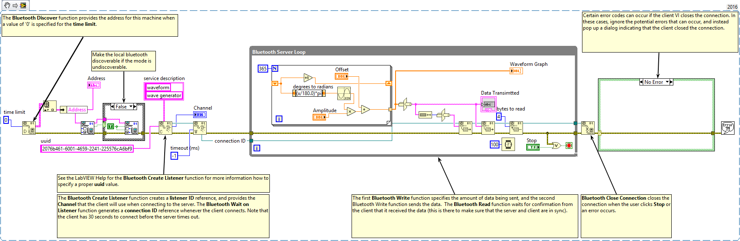
Server VI - Overall
Explain: This VI sets the Bluetooth on local computer discoverable creating a service “waveform” waiting for remote computer’s connection request. Once the connection has been made. It transmit a sine wave data to remote computer.

Slide 4
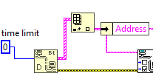
Bluetooth Discover
Searches for all locally installed or other Bluetooth devices within the range of the Bluetooth network.
Input
Time limit ms (I32) Max = 30000 Min = 10000 When less or equal to 0, this function returns a list of local installed Bluetooth devices.
Output
Number of Devices (U16) how many Bluetooth devices the function detects on the network.
Device list (Cluster[String, String])
Address identifies a device on the Bluetooth network
Device Name indicates the name of the Bluetooth device.
Explain: Discover the local device address for setting device discoverable and connectable.

Slide 5
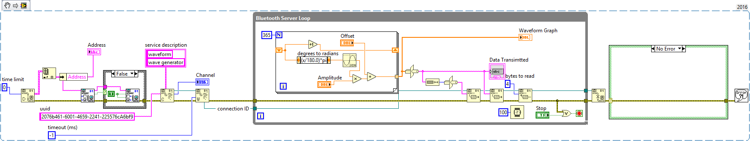
Bluetooth Get Mode VI
Returns the discoverable and connectable status of the local Bluetooth device.
Input
Address in (String) specifies the Bluetooth address of the local device.
Output
Address out (String) returns the same address as “Address in”
Discoverable (Boolean) returns TRUE if the device allows other Bluetooth devices to discover the device.
Connectable (Boolean) returns TRUE if the device allows connections
Explain: Obtain the Bluetooth mode.

Slide 6
Bluetooth Set Mode VI
Sets the discoverable and connectable status of the local Bluetooth device.
Input
Address in (String) specifies the Bluetooth address of the local device.
Discoverable (Boolean) determines if the device allows other Bluetooth devices to discover the device.
Connectable (Boolean) determines if the device allows other Bluetooth devices to connect to the device. The default is TRUE
Output
Address out (String) returns the same address as “Address in”
Explain: The mode is obtained. If the Bluetooth is in undiscoverable mode, we make it discoverable in order to be seen and reached by other computers.

Slide 7
Bluetooth Create Listener Function
Creates a service for a Bluetooth server and returns a Bluetooth channel the server can use to listen for inbound connections.
Input
Address in (String) specifies the Bluetooth address of the local device.
UUID (String) - Required identifies the service.
Service Discription (Cluster[String, String])
Name Name is the name of the service
Description Description is a short description of the service
Output
Listener ID (Network Refnum) a network connection refnum that uniquely identifies the listener.
Channel (U32) Returns the channel assigned to listener
Explain: Creates a waveform service for the client computer to establish the connection. The client need the Address and Channel to make the connection.

Slide 8
Bluetooth Wait On Listener Function
Waits for the listener to accept a connection request.
Input
Listerer ID (Network Refnum) - Required A network connection refnum that uniquely identifies the listener.
Timeout ms (I32) Specifies the time, in milliseconds, that the function waits for a connection. If a connection is not established in the specified time, the function returns an error. The default value is –1, which indicates to wait indefinitely.
Output
Listerer ID (Network Refnum) a network connection refnum that uniquely identifies the listener.
Remote Address (String) Client’s address
Remote Channel (U16) returns the channel of the Bluetooth client.
Connection ID (Network Refnum) a network connection refnum that uniquely identifies the Bluetooth connection.
Explain: Once the service is created. This function is waiting for the connection from client to establish the connection to the service.

Slide 9
Generate waveform data
This for loop generates a Sine wave
Explain: After the connection established. The program generates a Sine wave with 365 points. The user can change the offset and the amplitude.

Slide 10
Formatting Data to string
Convert the data into a specific format and data structure.
Input
Data (Array[DBL]) An array of data
Output
Data Length (string) Data size information in string format
Data (String) Actual data in string format
Explain: The data must be transmitted in a string. This procedure converts the “data length” and “data content” into the string. In this case, we simply use type cast function to convert the data. Data length contain the data size information. Remote computer relies on this to determine how many bytes need to be read.

Slide 11
Type Cast Function
Casts x to the data type, type, by flattening it and unflattening it using the new data type.
Input
Type (Any) The data type to which you want to convert the data. Wire any constant or control to type to set the data type to which you want to convert the data. LabVIEW ignores any data in the constant or control you wire to type.
X (Any) The data you want to convert to type. x can be any data type.
Output
*(type *) &x The value provided in x and converted to the same data type that sent from input
Explain: Converting any kind of data into string. In this case, it converts “data length (I32)” and “Data(Array[DBL])” to string.

Slide 12
Bluetooth Write Function
Writes data to a Bluetooth network connection.
Input
Connection ID (Network Refnum) A network connection refnum that uniquely identifies the listener.
Data in (String) contains the data you want to write to the connection. *Please refer to LabVIEW help to find the techniques to handle messages that might vary in size.
Timeout ms (U32) the function waits for the connection. The default is 25,000 ms. A value of –1 indicates to wait indefinitely.
Output
Connectiong ID (Network Refnum) returns the same value as connection ID
Bytes written (I32) indicates the number of bytes the function wrote.
Explain: Write the string data to designated Bluetooth connection. Another computer on this connection can read the data which you wrote here.

Slide 13
Bluetooth Read Function
Waits for the listener to accept a connection request.
Input
Mode (Enum) Indicates the behavior of the read operation
Connection ID (Network Refnum) a network connection refnum that uniquely identifies the Bluetooth connection.
Bytes to read (I32) The number of bytes to read. *Please refer to LabVIEW help to find the techniques to handle messages that might vary in size.
Timeout ms (U32) specifies the time, in milliseconds, that the function waits for the connection. The default is 25,000 ms. A value of –1 indicates to wait indefinitely.
Output
Connection ID (Network Refnum) a network connection refnum that uniquely identifies the Bluetooth connection.
Data out (String) Data out contains the data the function read from the Bluetooth connection.
Explain: Read the response from another computer. This is demonstrating that server and client can communicate in either direction.

Slide 14
Bluetooth Close Connection Function
Waits for the listener to accept a connection request.
Input
Connection ID (Network Refnum) a network connection refnum that uniquely identifies the Bluetooth connection.
Output
Connection ID (Network Refnum) connection ID out returns the same value as connection ID.
Explain: Once the service is created. This function is waiting for the connection from client to establish the connection to the service.

Slide 15
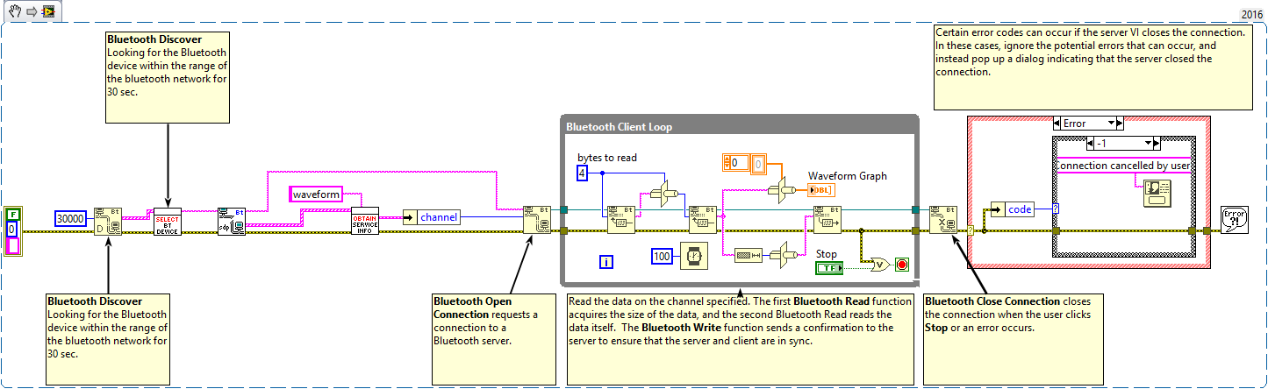
Client VI - Overall
Explain: This VI searches for all available devices in Bluetooth range. It asks the user to select the device that the user wants to connect and find a certain service to establish the connection to receiving and transmitting the data.

Slide 16
Bluetooth Discover
Searches for all locally installed or other Bluetooth devices within the range of the Bluetooth network.
Input
Time limit ms (I32) Max = 30000 Min = 10000 When less or equal to 0, this function returns a list of local installed Bluetooth devices.
Output
Number of Devices (U16) how many Bluetooth devices the function detects on the network.
Device list (Cluster[String, String])
Address identifies a device on the Bluetooth network
Device Name indicates the name of the Bluetooth device.
Explain: Discover the remote devices address for 30 sec.

Slide 17
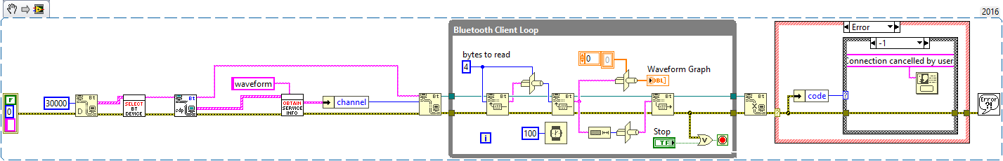
Select Bluetooth Device
This is a custom made VI. It prompts a window for the user to choose which device wants to connect in the Bluetooth range
Input
Device list (Cluster[String, String])
Address identifies a device on the Bluetooth network
Device Name indicates the name of the Bluetooth device.
Output
Address (String) The address of device that the user select
Explain: Ask the user to choose the device that he wants to connect.

Slide 18
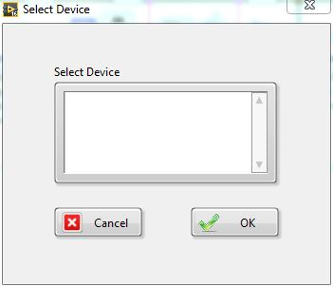
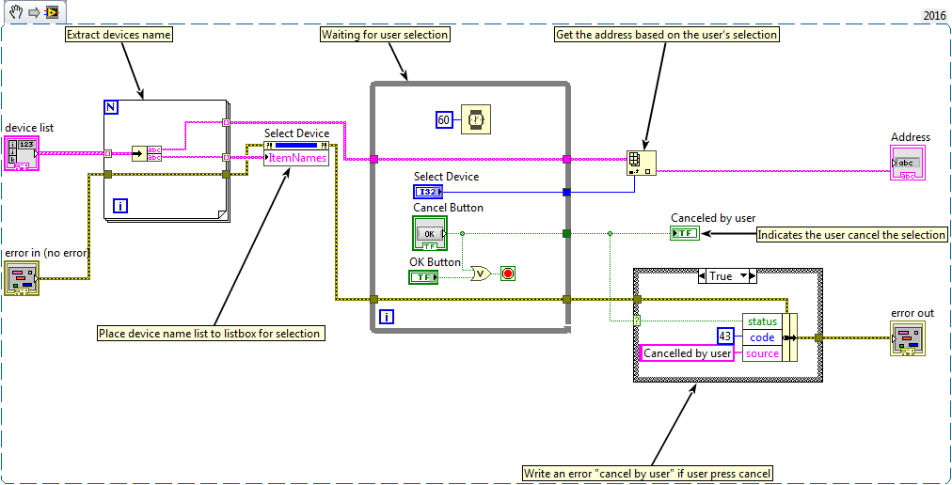
Select Bluetooth Device
Front Panel
Block Diagram

Slide 19
Bluetooth RFCOMM Service Discovery VI
Returns a list of services available from a Bluetooth address.
Output
Address out (String) returns the same address as “Address in”
Number of Services (I32) how many Bluetooth devices the function detects on the network.
Service list (Array of Cluster)
Channel (U32) The channel of service
UUID (string) Identifier of the service
Service Name Name of Service
Service Description The description of service
Input
Address in (String) specifies the Bluetooth address of the remote device.
Explain: Discover the list of service that the device which the user’s selection has.

Slide 20
Obtain Service Info
This is a custom made VI. Find the communication parameters for certain service name
Input
Service list (Array of Cluster)
Channel (U32) The channel of service
UUID (string) Identifier of the service
Service Name Name of Service
Service Description The description of service
Service Name (String) The service wanted to connect
Output
Service Info (Cluster) Service information corresponded to designated service
Explain: Finding the remote “waveform” service information for further connection.

Slide 21
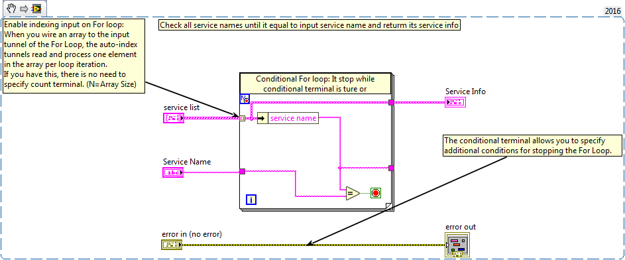
Obtain Service Info
Block Diagram

Slide 22
Bluetooth Open Connection
Requests a connection to a Bluetooth server.
Input
Address in (String) Specifies the Bluetooth address of the remote device.
Channel (U16) The channel number on the Bluetooth server. If channel is zero, this function uses the UUID to specify the service to connect to.
Timeout ms (I32) Specifies the time, in milliseconds, that the function waits for the connection. The default is 60000 ms. A value of –1 indicates to wait indefinitely.
UUID (String) The unique identifier for the service. If channel is zero, this function uses the UUID to specify the service.
Output
Connection ID (Network Refnum) a network connection refnum that uniquely identifies the Bluetooth connection.
Explain: Connecting to the server base on remote computer address and channel that previously obtained.

Slide 23
Bluetooth Read Function
Waits for the listener to accept a connection request.
Input
Mode (Enum) Indicates the behavior of the read operation
Connection ID (Network Refnum) a network connection refnum that uniquely identifies the Bluetooth connection.
Bytes to read (I32) The number of bytes to read. *Please refer to LabVIEW help to find the techniques to handle messages that might vary in size.
Timeout ms (U32) specifies the time, in milliseconds, that the function waits for the connection. The default is 25,000 ms. A value of –1 indicates to wait indefinitely.
Output
Connection ID (Network Refnum) a network connection refnum that uniquely identifies the Bluetooth connection.
Data out (String) Data out contains the data the function read from the Bluetooth connection.
Explain: Read data from the server. First, read 4 bytes to determine how many bytes are in data. Second, based on how many data, read certain amount of data bytes.

Slide 24
Bluetooth Write Function
Writes data to a Bluetooth network connection.
Input
Connection ID (Network Refnum) A network connection refnum that uniquely identifies the listener.
Data in (String) contains the data you want to write to the connection. *Please refer to LabVIEW help to find the techniques to handle messages that might vary in size.
Timeout ms (U32) the function waits for the connection. The default is 25,000 ms. A value of –1 indicates to wait indefinitely.
Output
Connectiong ID (Network Refnum) returns the same value as connection ID
Bytes written (I32) indicates the number of bytes the function wrote.
Explain: Write back how many bytes of data is received. The server can use this information to acknowledge that all the data has been received by the client. Or, you can use this function to communicate back and forth between two computers.

Slide 25
Glossary
Address A 48 bit address used to identify each Bluetooth enabled device. For example: 48-2C-6A-1E-59-3D.
Channel The physical frequency that Bluetooth devices communicate.
Client A device or a program that is capable of obtaining information and applications from a server.
Server A device or a program that manages access to a centralized resource or service in a network.
UUID Universally unique identifier (UUID) is an identifier standard used in software construction. A UUID is simply a 128-bit value.

